Slide 1
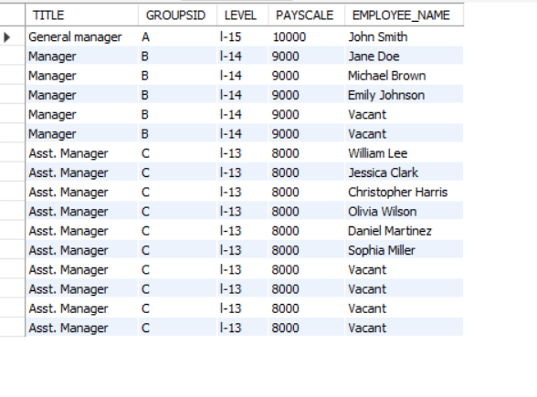
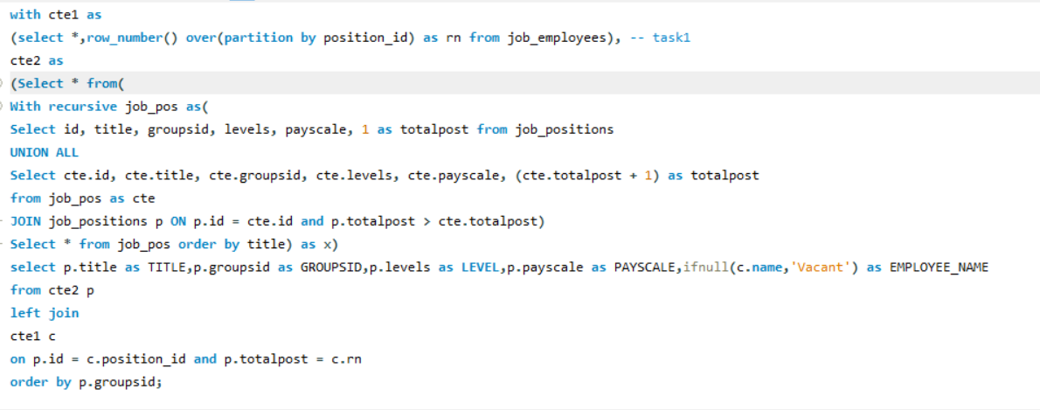
Query: Write a query to show the hierarchy of job position for each employee record
Output

Slide 2
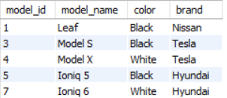

Query: Delete duplicate data
Output

Slide 3
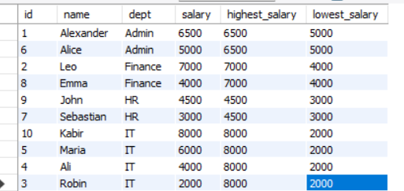
Query: Display highest and lowest salary from the given employee table based on each department and display the employee record

Slide 4

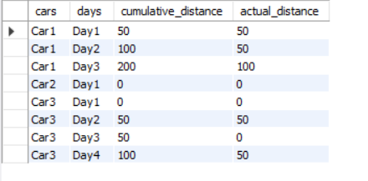
Find actual distance ---

Slide 5
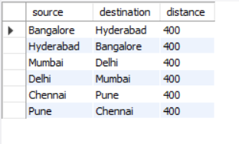
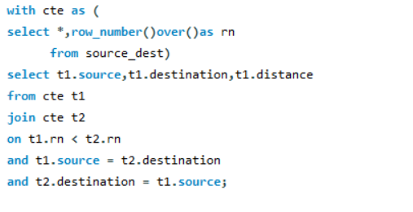
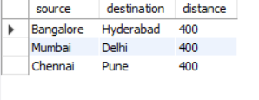
From the input , expected output one source and one destination , no vice versa
Actual input
Query
Output

Slide 6
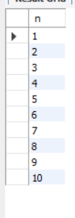
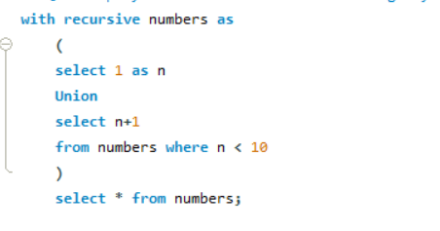
Display numbers 1 to 10 without using any build in function
Recursive SQL problem

Slide 7

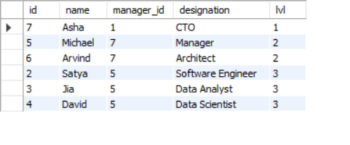
Find the hierarchy of employees under a given manager "Asha"

Slide 8
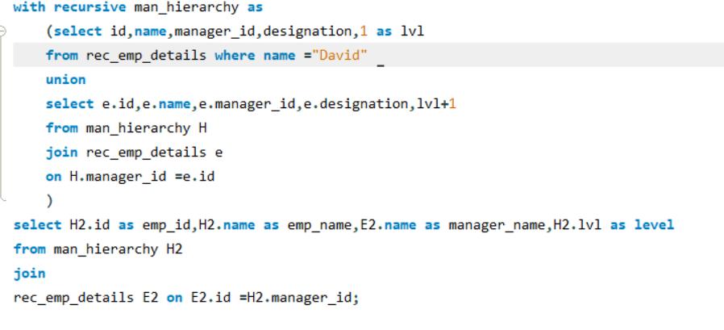
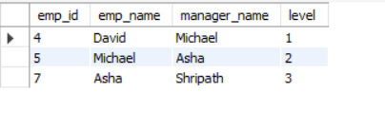
Find the hierarchy of managers for a given employee 'David'

Slide 9
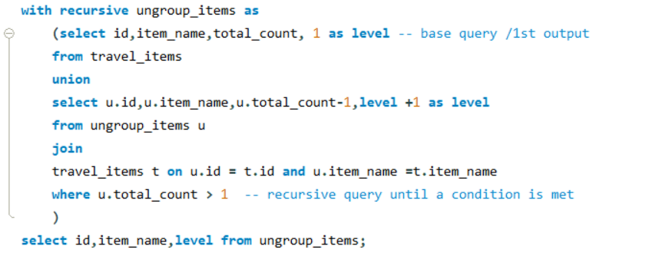
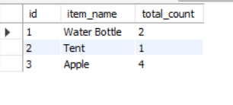
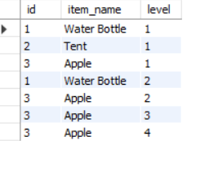
Ungroup the given input data
Actual input

Slide 10

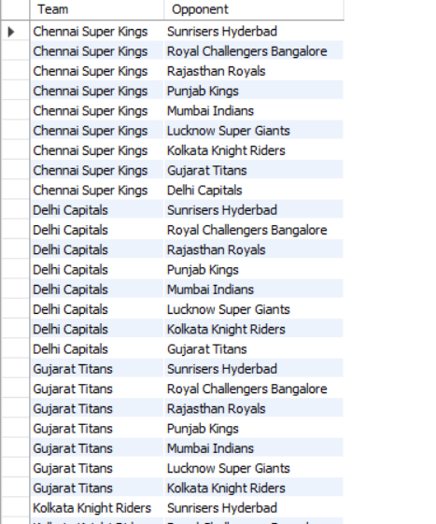
Sample output
IPL Matches ---write a query such that each team played only once with all other teams

Slide 11
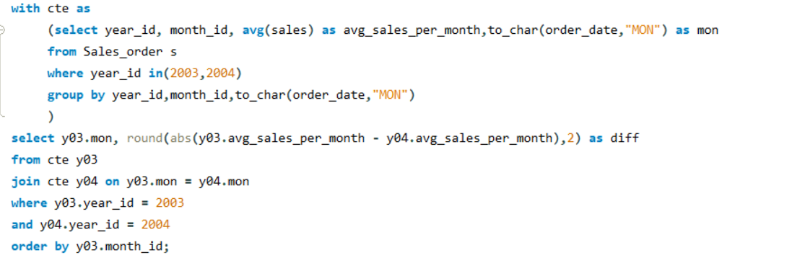
Find difference in average sales ---

Slide 12

Pizza Delivery Status

Slide 13
